Slide 1

Airline Database: Managing Flights and Reservations
Welcome! Today, we'll delve into the world of airline databases, exploring the core entities and their interconnections. We'll see how a well-structured database can help streamline operations, enhance customer experience, and drive success.
PM
by Penguins Groups

Slide 2
Database Entities: Building Blocks of Airline Management
Core Entities
Relationships
Passengers, Flights, Airports, Aircraft, Bookings, Employees, Reporting & Analytics
Bookings link passengers to flights, flights connect airports, aircraft hold passengers, and employees manage the entire system.

Slide 3

Passenger Entity: Capturing Traveler Data
Details
Booking Information
Name, Contact Information, Travel Preferences, Loyalty Program Status, Special Needs
Reservation Number, Flight Details, Seat Selection, Payment Information, Travel Itinerary

Slide 4




Flight Entity: Scheduling and Availability
Details
Flight Number, Departure & Arrival Airports, Scheduled Departure & Arrival Times, Aircraft Type, Seat Availability
Schedule
Daily, Weekly, or Monthly Schedules, Route Information, Flight Durations, Connecting Flights
Availability
Real-Time Seat Availability, Fare Classes, Booking Restrictions, Special Services

Slide 5

Airport Entity: Hubs of Global Travel
1
Airport Codes
2
Locations
Unique identifiers for each airport, such as IATA and ICAO codes, facilitating communication and navigation.
Precise geographic coordinates, time zones, and address information for airport identification and operational planning.
3
Facilities
Infrastructure details like terminals, gates, runways, baggage handling systems, and amenities, supporting airport operations and passenger experience.

Slide 6
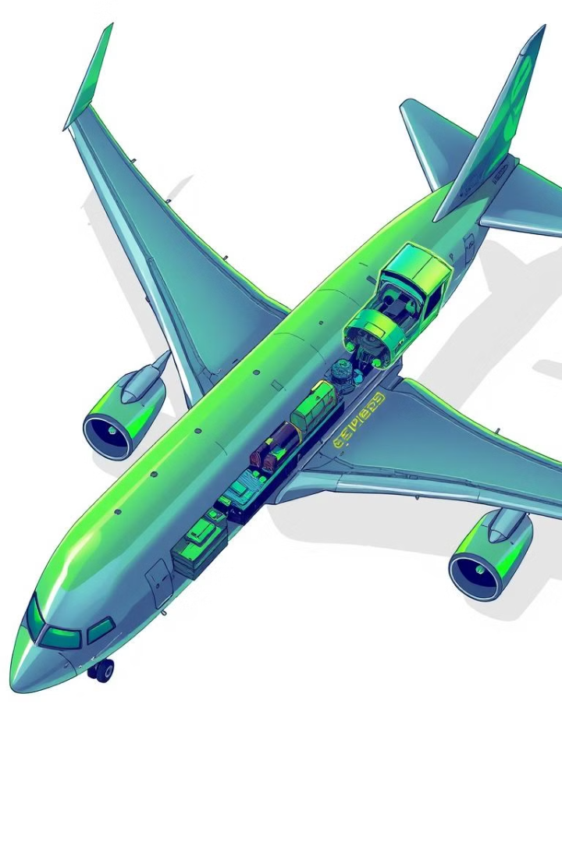
Aircraft Entity: Wings of the Airline
1
Aircraft Types
Models, Seating Configurations, Engine Specifications, Performance Characteristics, catering to different travel needs and preferences.
2
Capacity
Passenger and Cargo Carrying Capacity, Class Distribution, Seat Pitch and Width, maximizing aircraft utilization and revenue.
3
Maintenance Records
Logbook of Inspections, Repairs, Parts Replacement, and Operational History, ensuring aircraft safety and operational reliability.

Slide 7
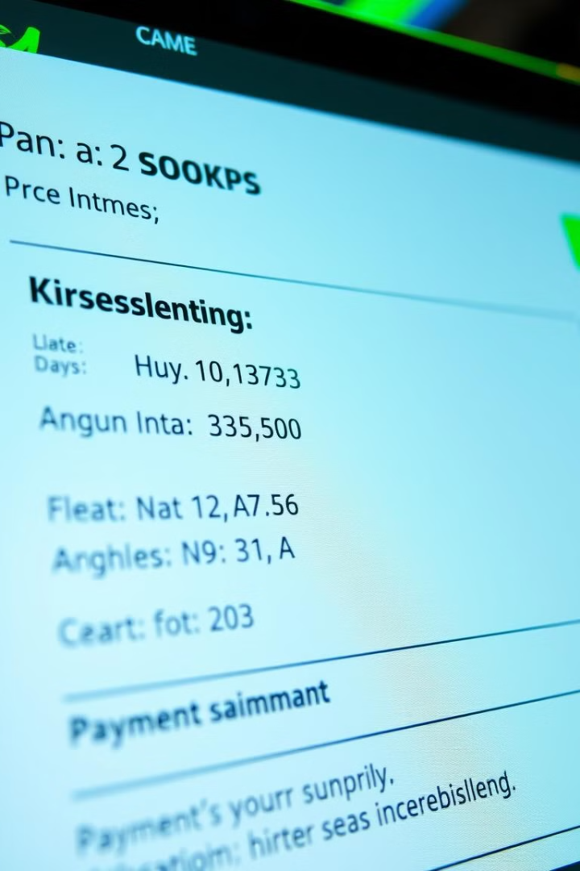



Booking Entity: Securing Your Journey
Reservation Details
Passenger Information, Flight Details, Seat Selection, Special Requests, and Baggage Allowance.
Payment Information
Payment Method, Amount, Currency, Transaction ID, and Payment Confirmation, ensuring secure and transparent financial transactions.
Confirmation
Booking Confirmation Number, Itinerary Summary, Boarding Pass Details, and Emergency Contact Information, providing essential information for travelers.

Slide 8





Employee Entity: Driving Airline Operations
Pilot
1
Operates Aircraft
Flight Attendant
2
Ensures Safety and Passenger Comfort
Ground Crew
3
Handles Aircraft on Ground
Customer Service
4
Assists Passengers
Management
5
Oversees Operations

Slide 9

Conclusion: The Power of a Robust Airline Database
A well-designed airline database is essential for efficient operations, enhanced customer experience, and data-driven decision-making. It enables seamless reservations, optimized flight schedules, and comprehensive insights into performance, ensuring a smooth and successful journey for passengers and the airline.

